Slide 1
Information Systems Project
This project is a hospital managing system, it have some managing features like:
Adding (Doctors, nurses and patients).
Get IDs (By person’s name).
Get Patients Data .
Get Staff Data & Salaries .

Slide 2
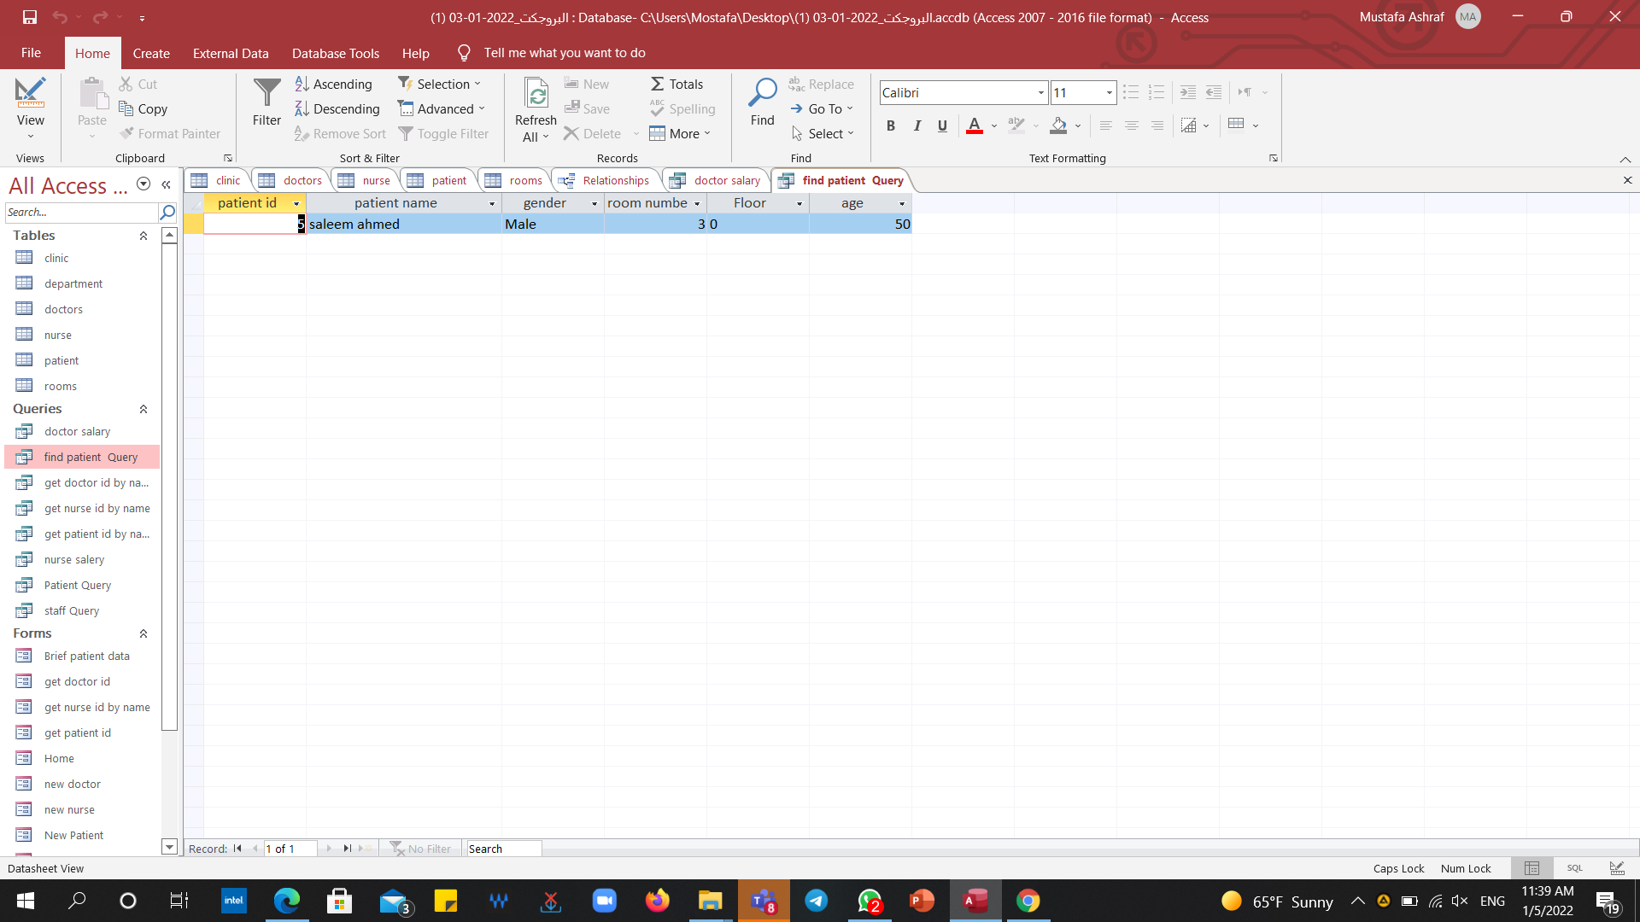
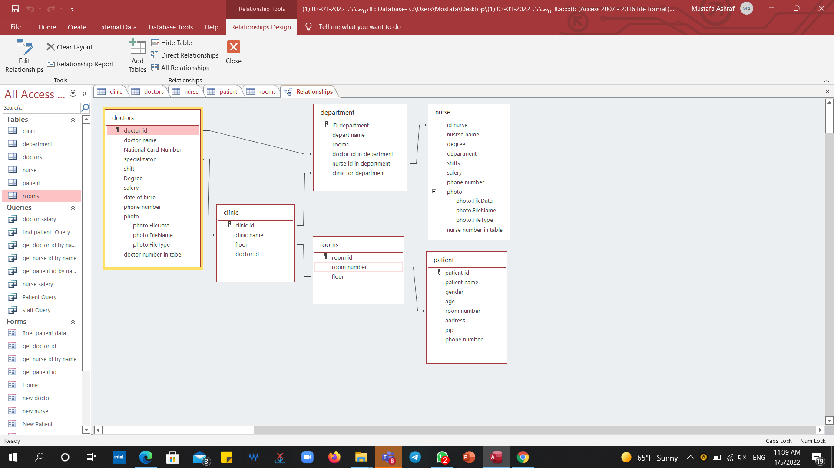
Components of the project
Tables
Relationship

Slide 3
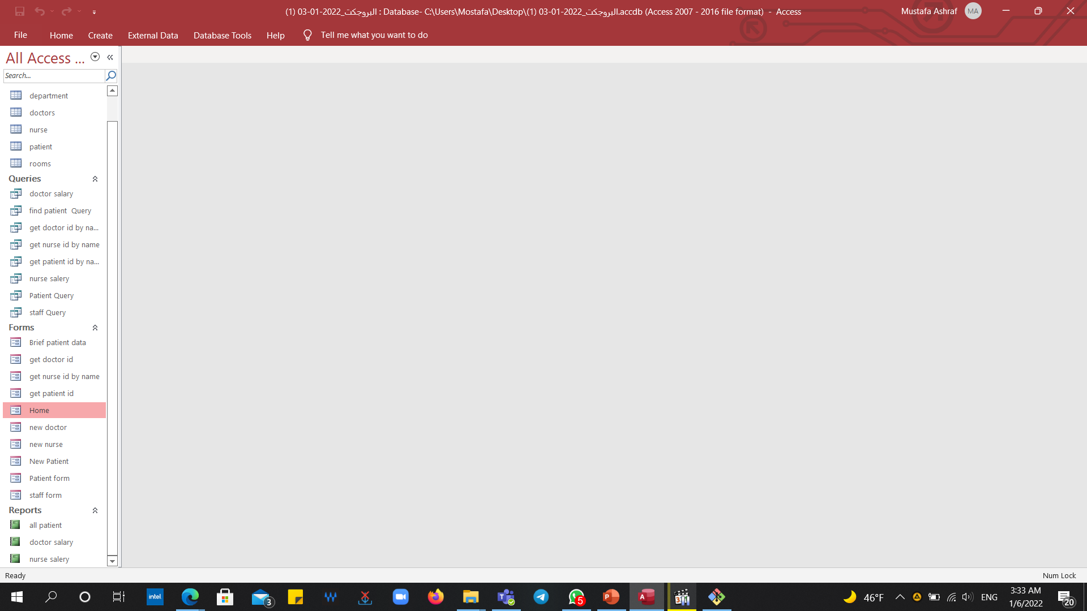
Components of the project
Queries
forms
Reports

Slide 4
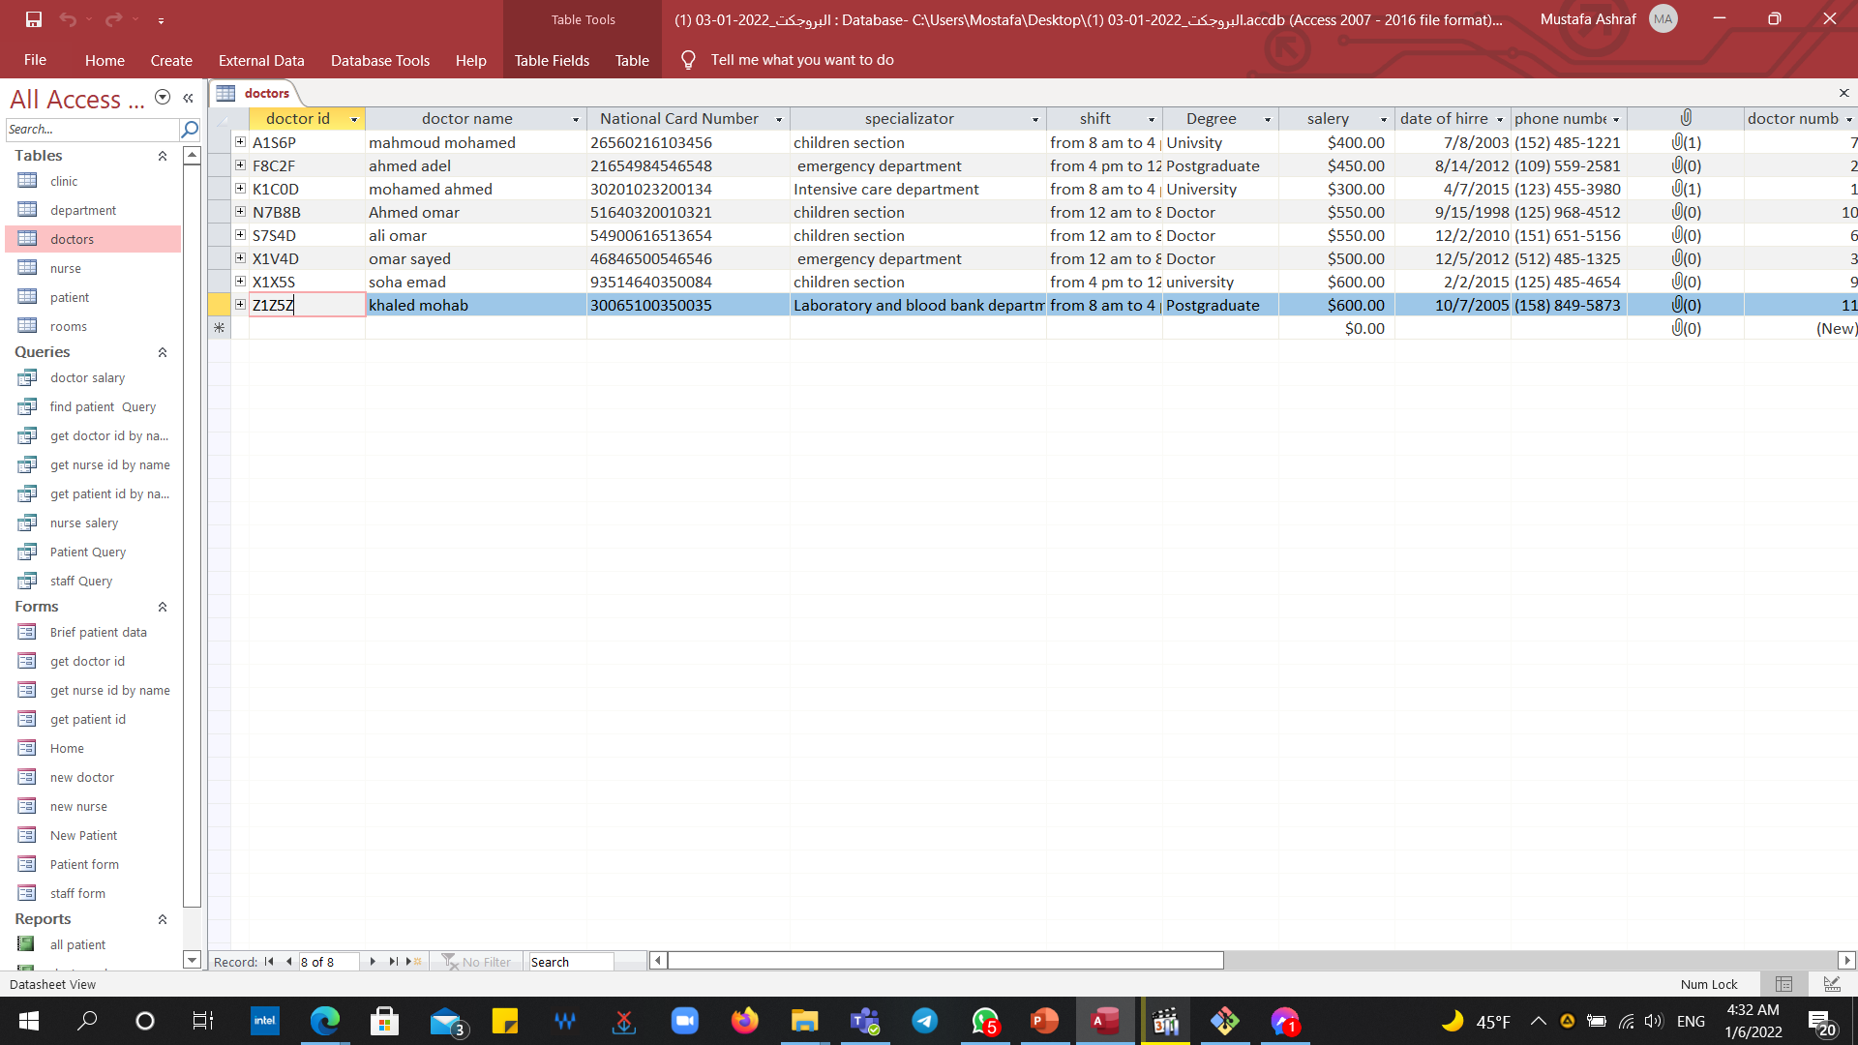
Tables : Doctor

Slide 5
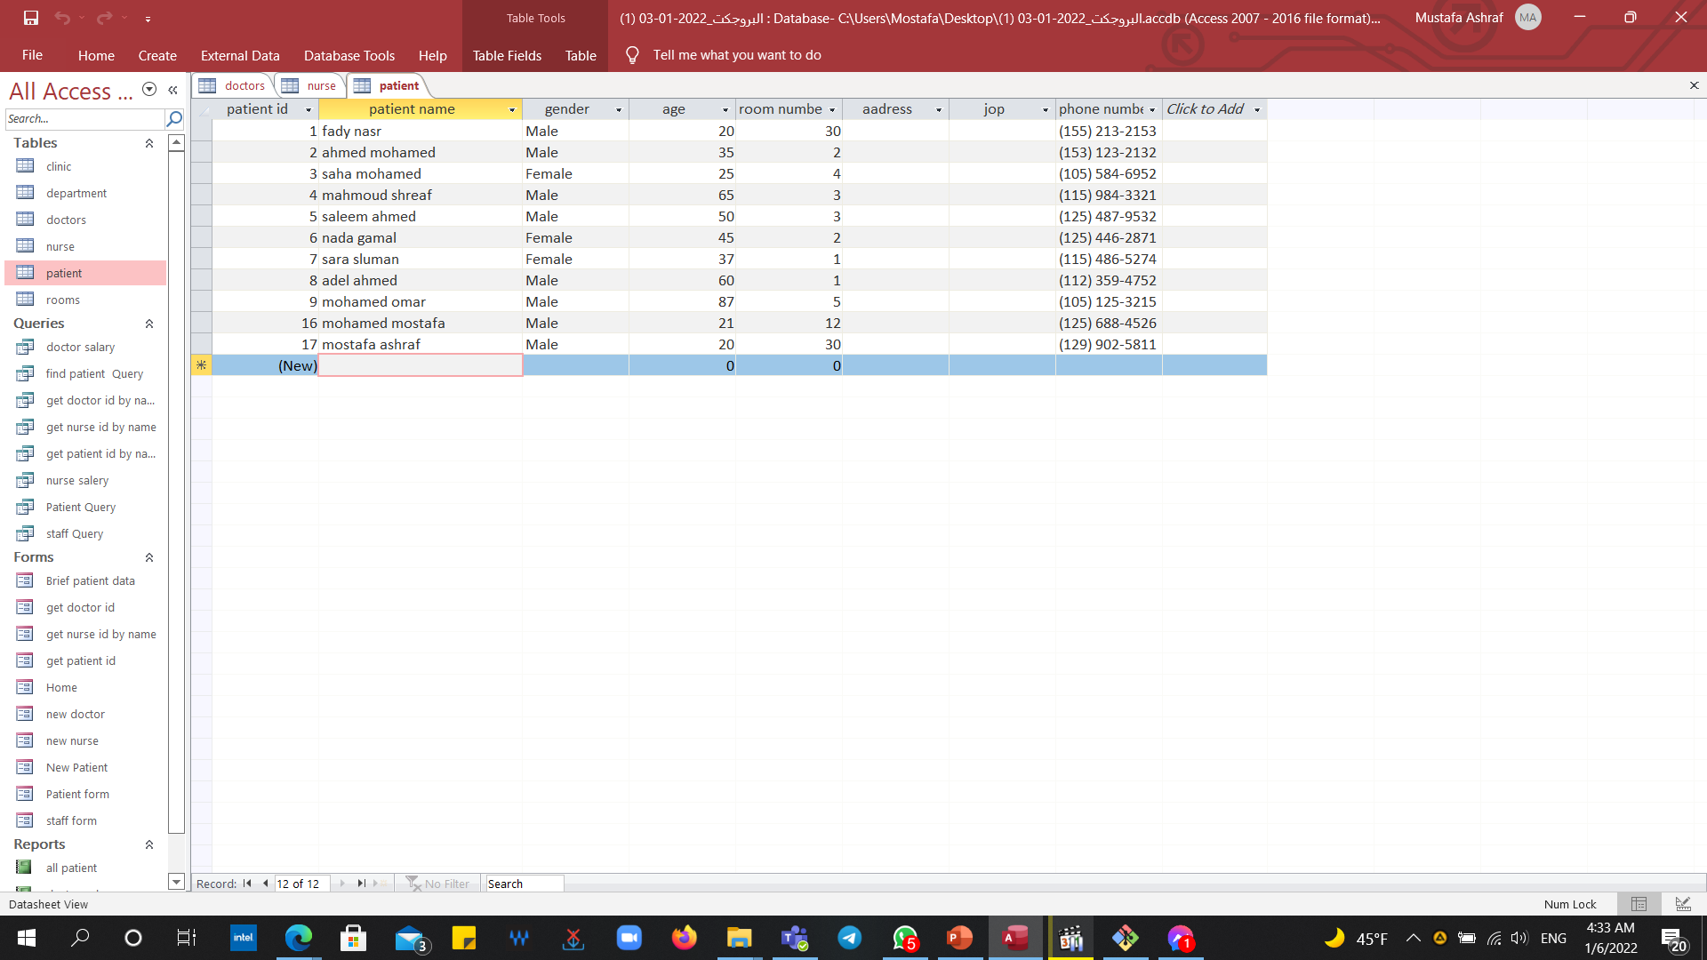
Patient

Slide 6
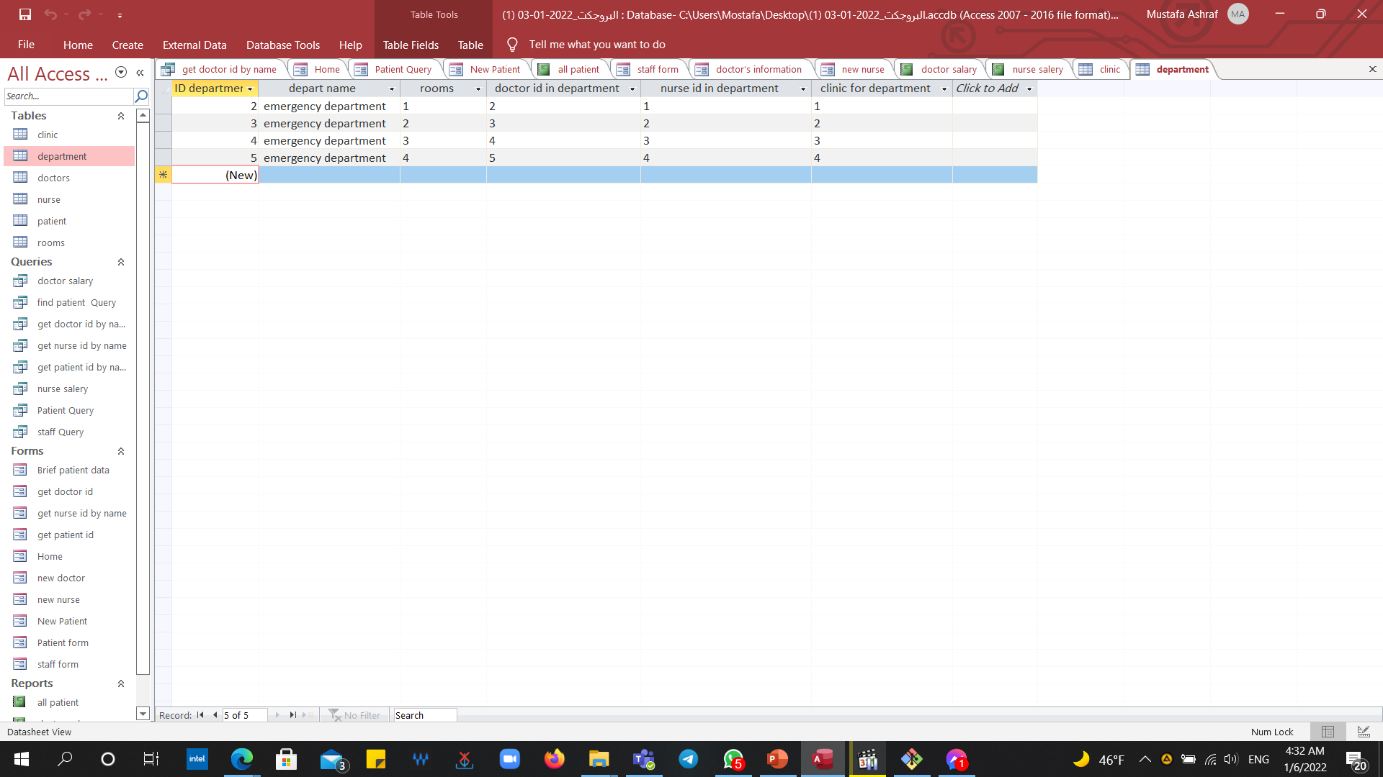
Department

Slide 7
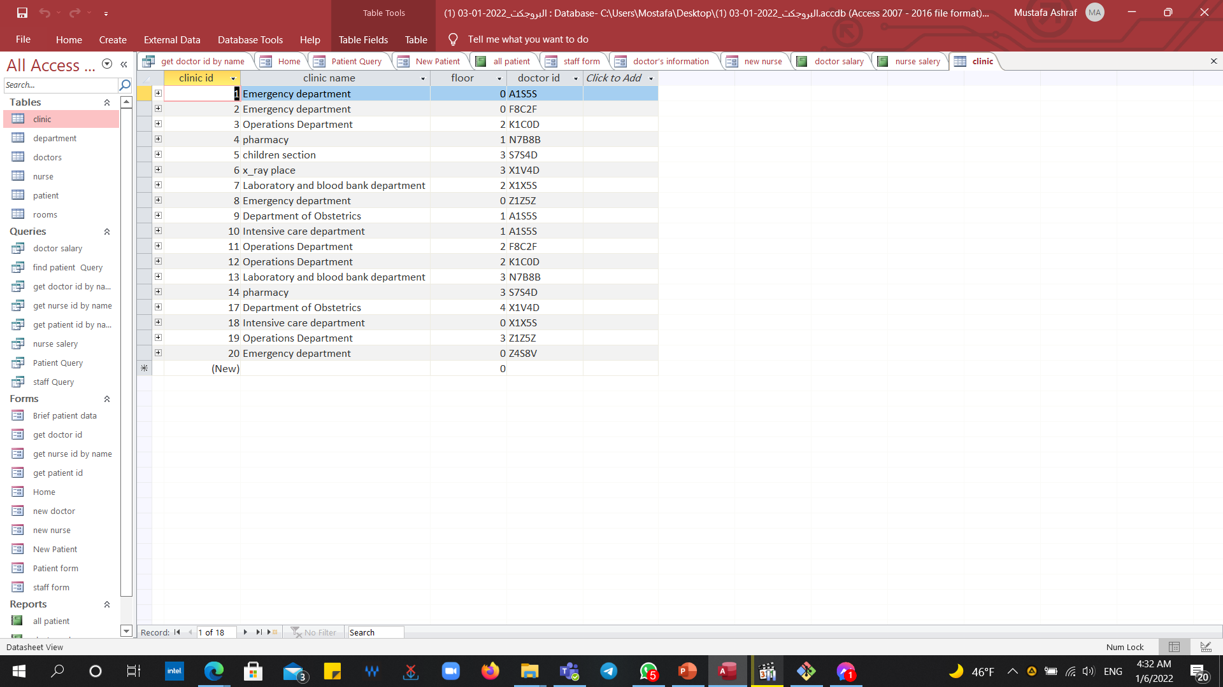
Clinic

Slide 8
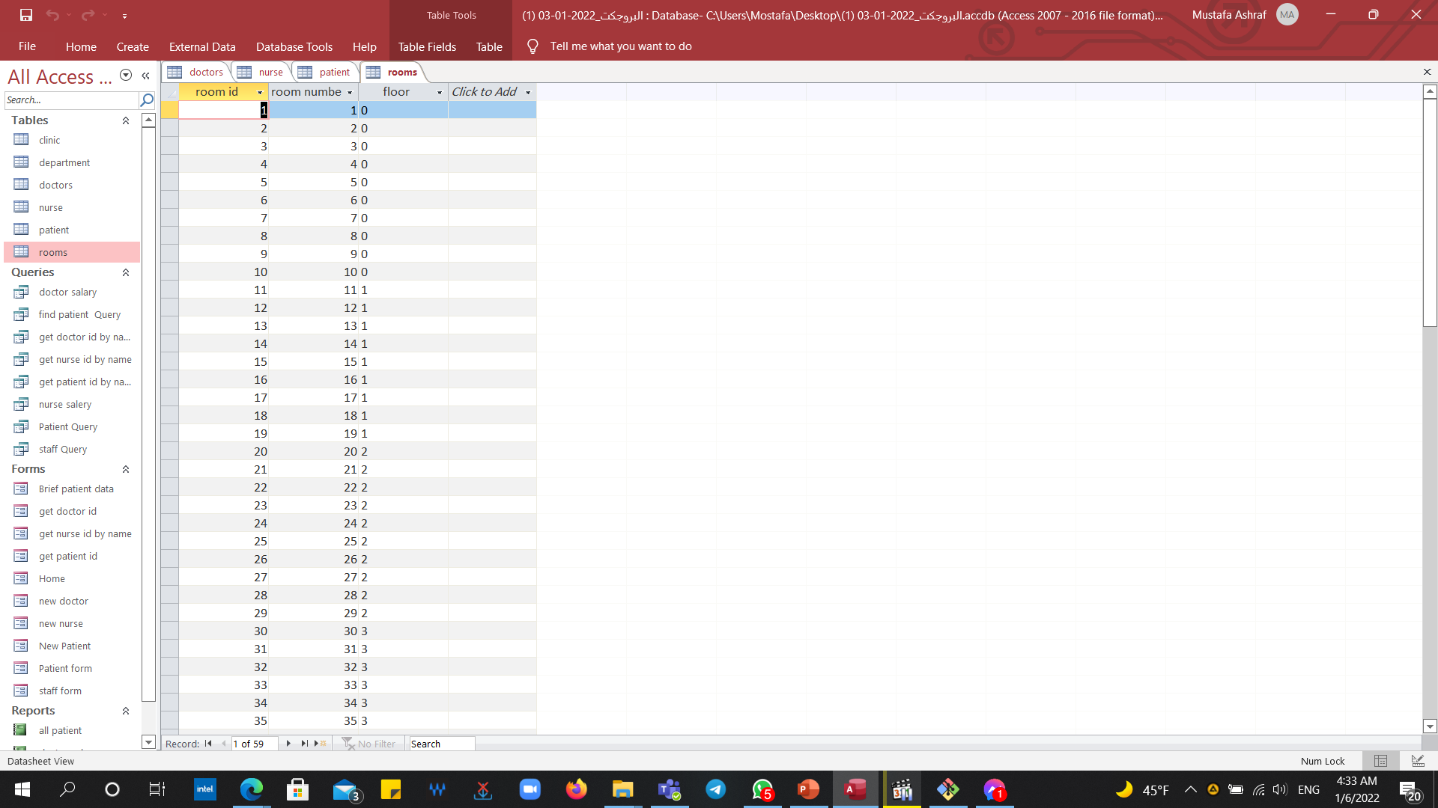
Rooms

Slide 9
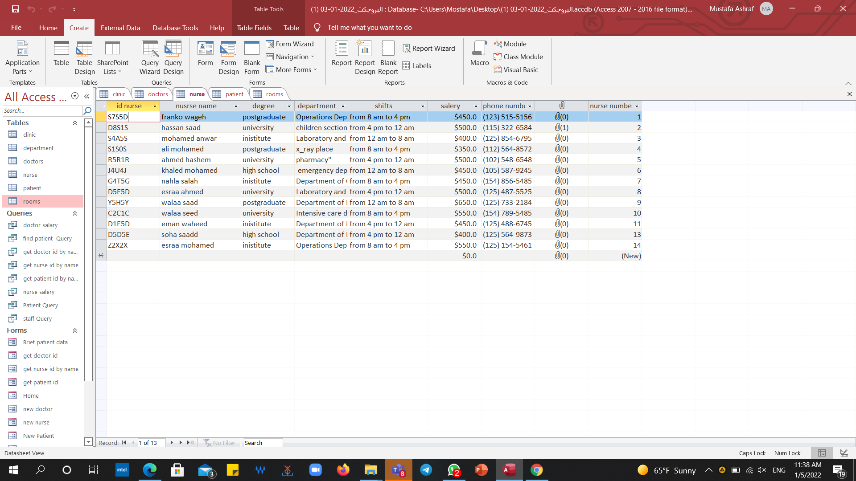
Nurse

Slide 10
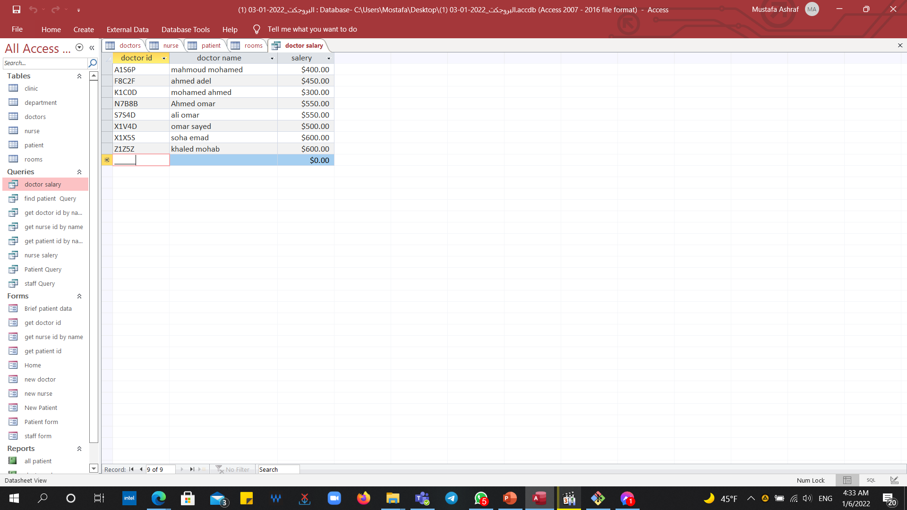
Queries : Doctor salary

Slide 11
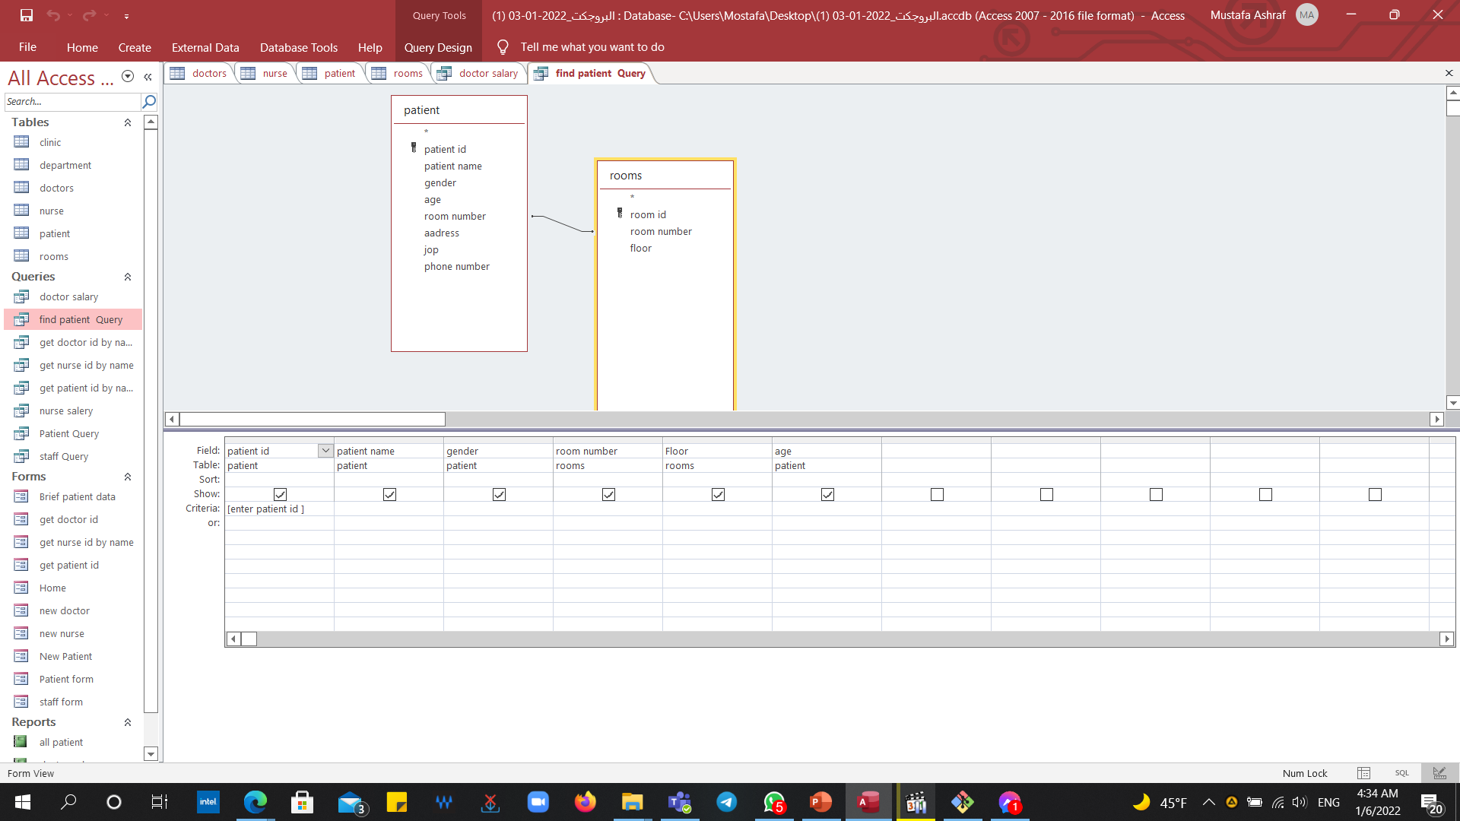
Find patient

Slide 12
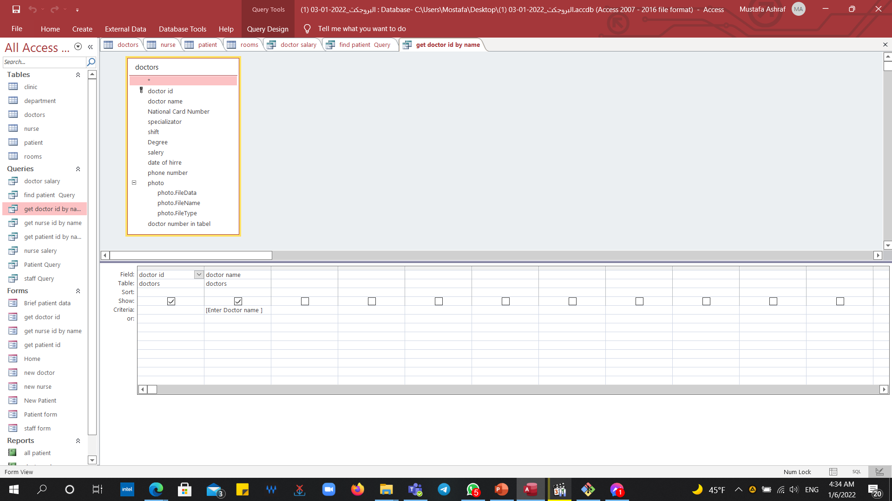
Get doctor id

Slide 13
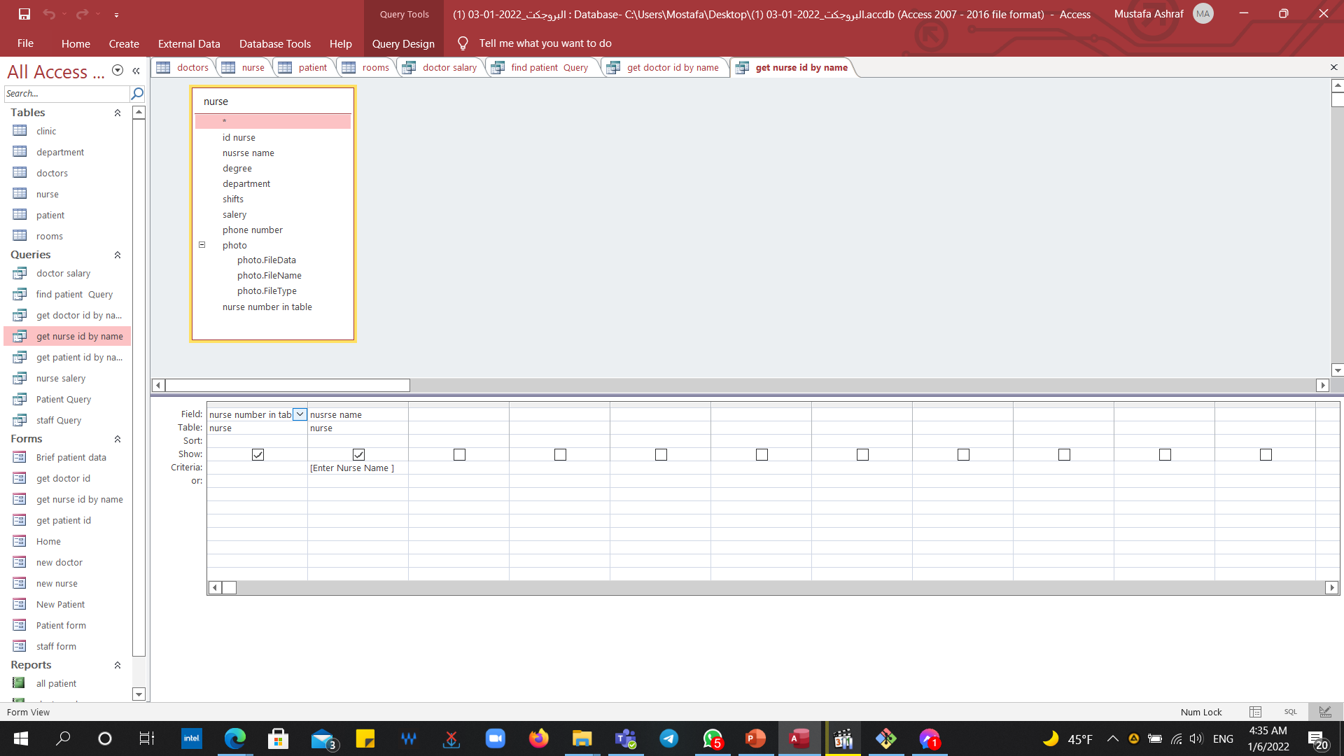
Get nurse id

Slide 14
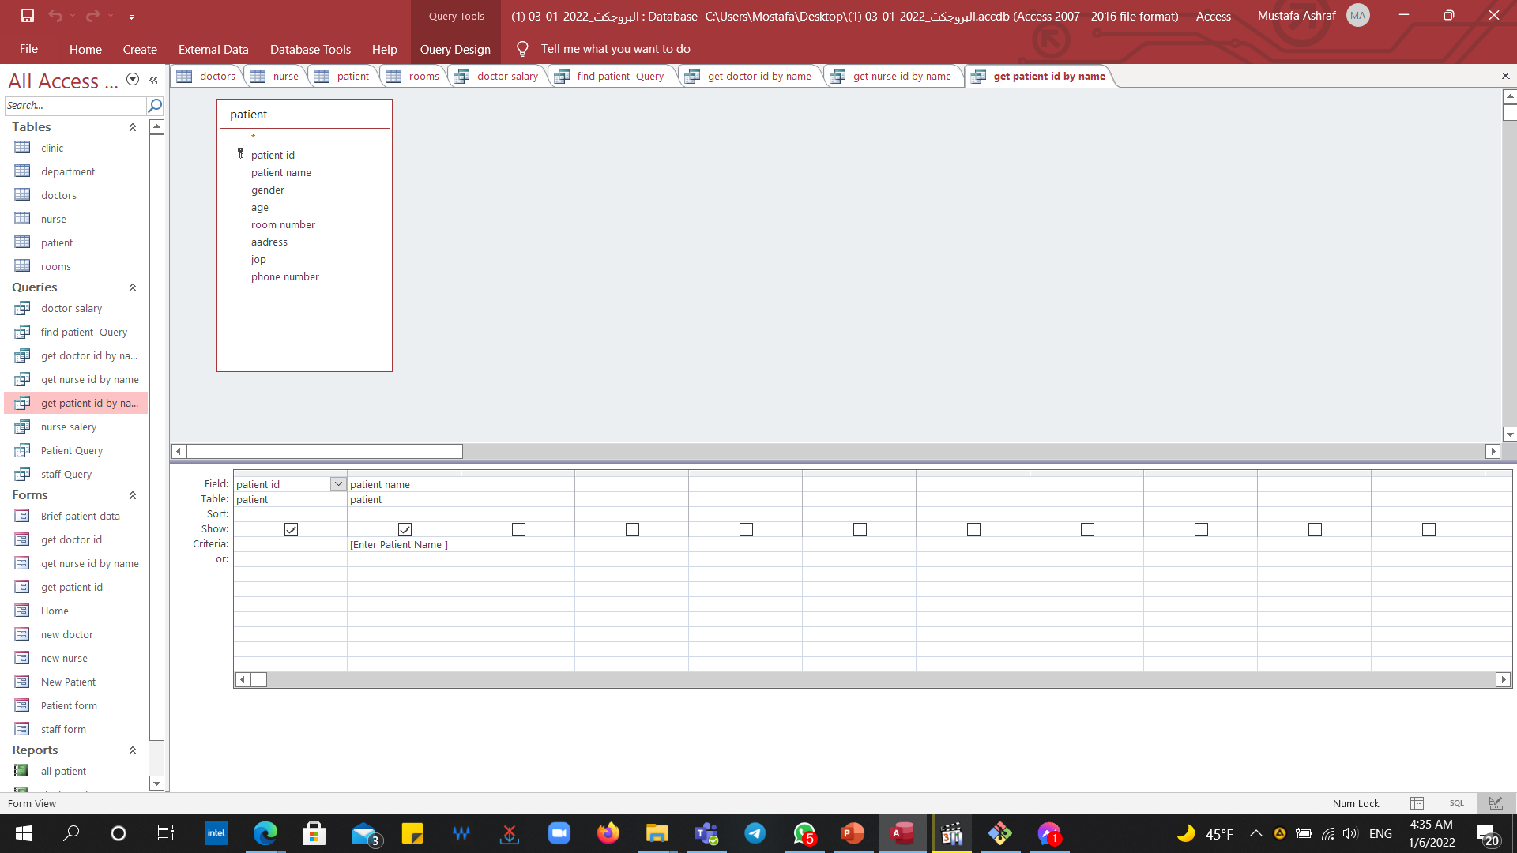
Get patient id

Slide 15
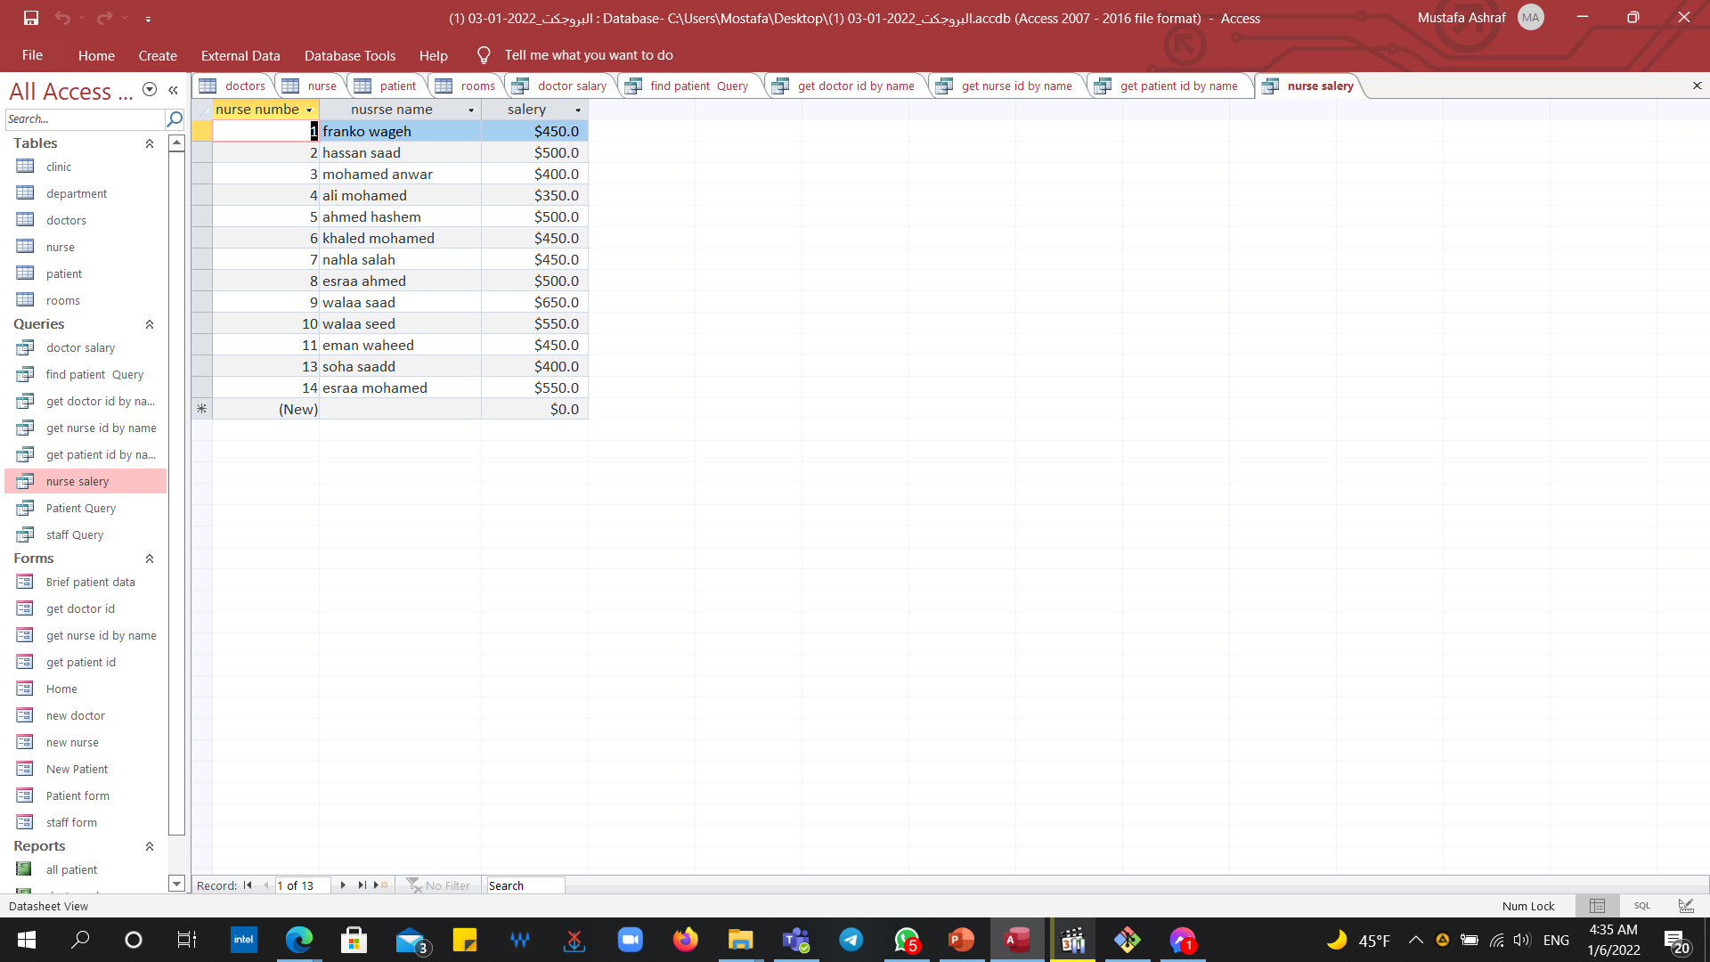
Nurse salary

Slide 16
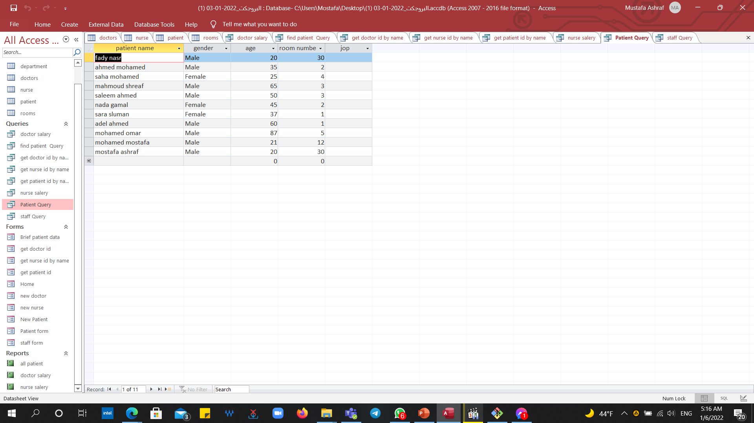
Patient

Slide 17
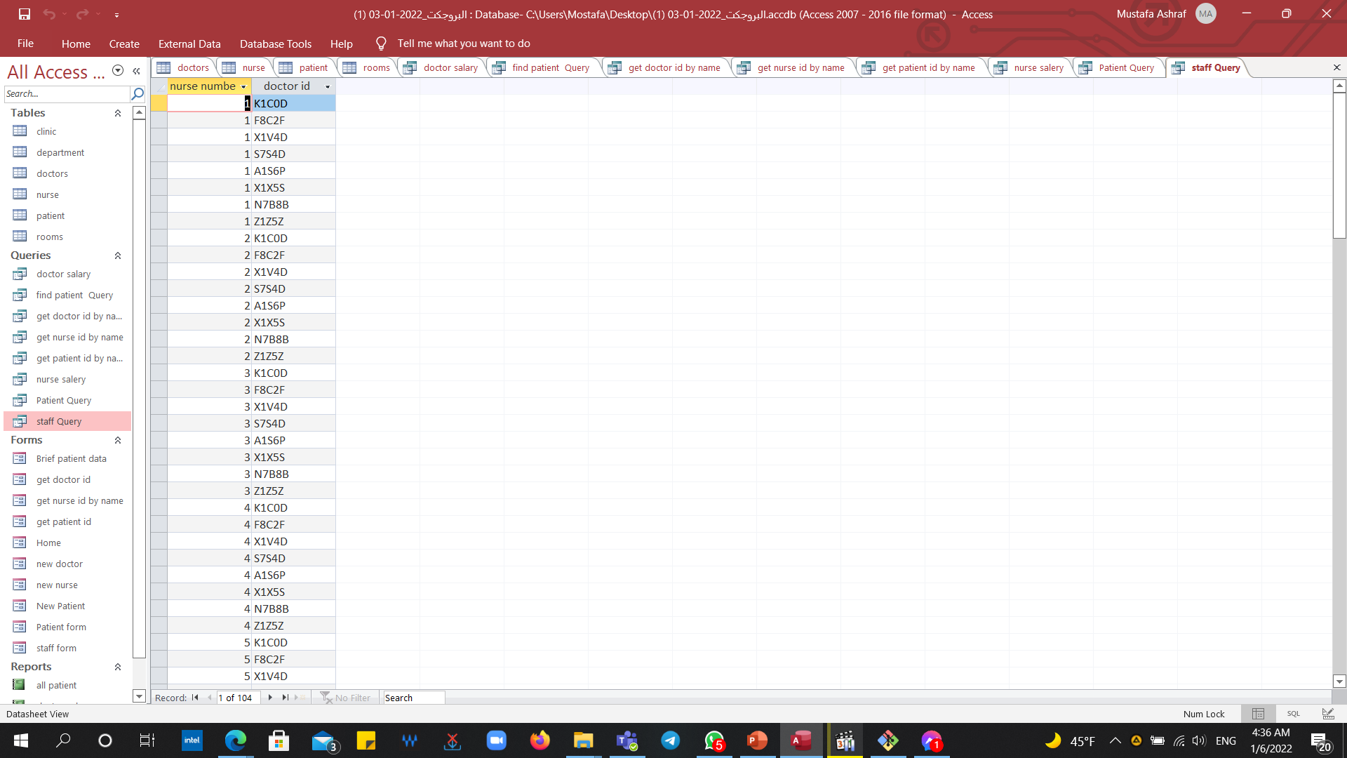
staff

Slide 18
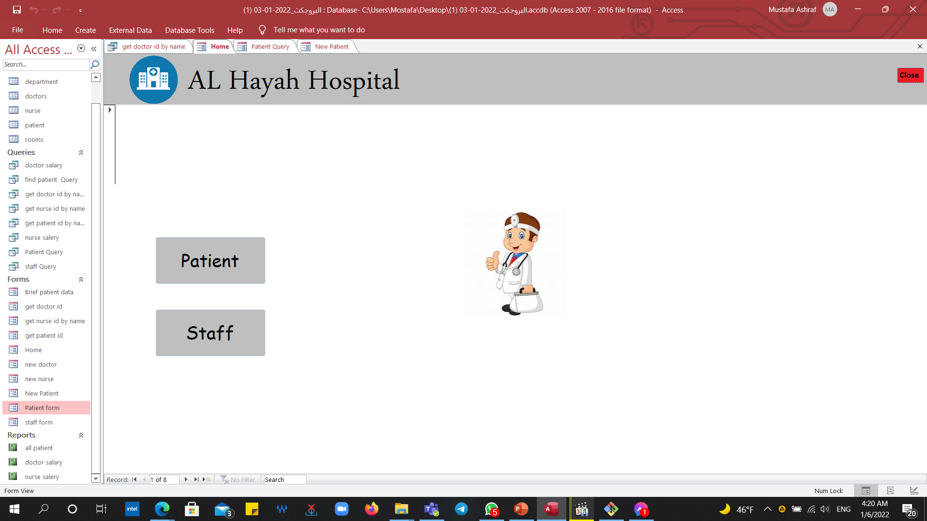
Forms : Home form

Slide 19
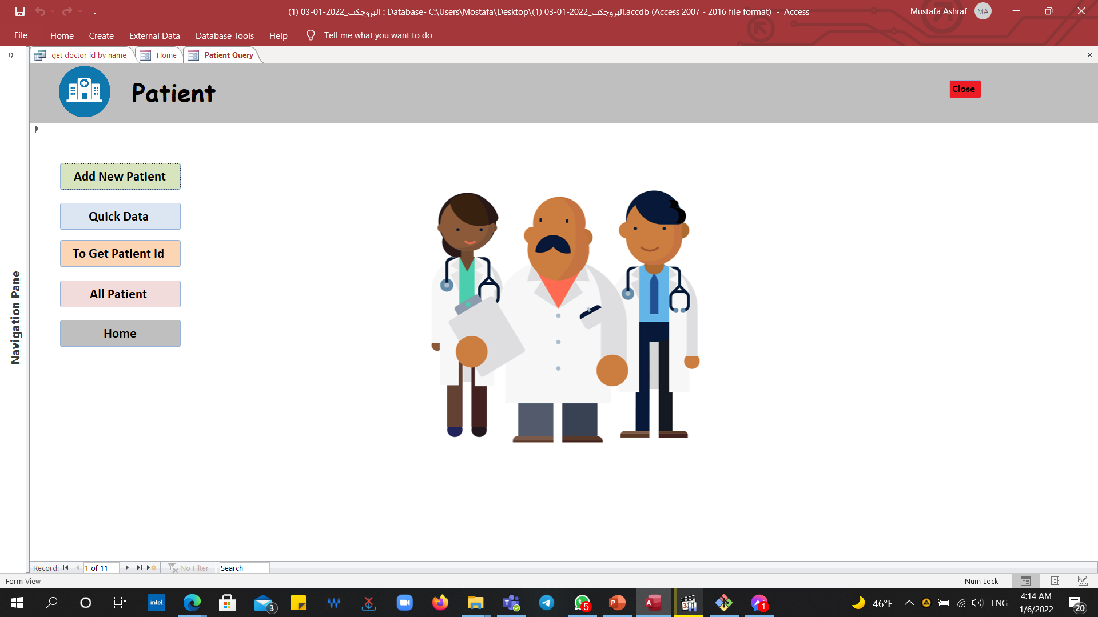

Slide 20
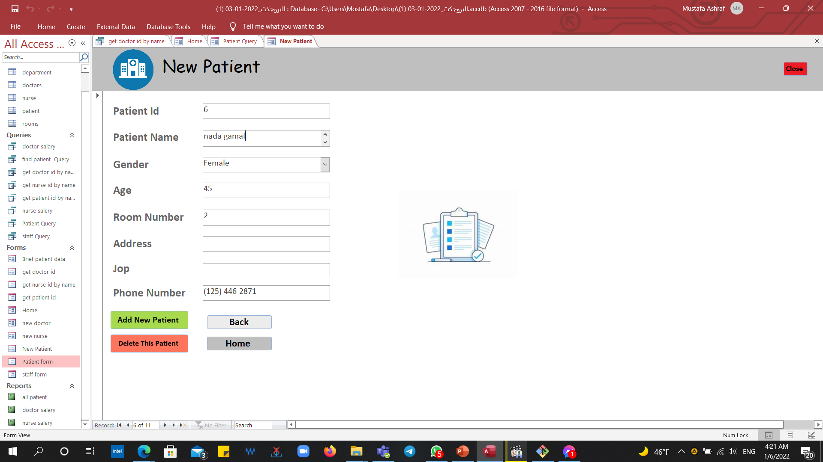

Slide 21
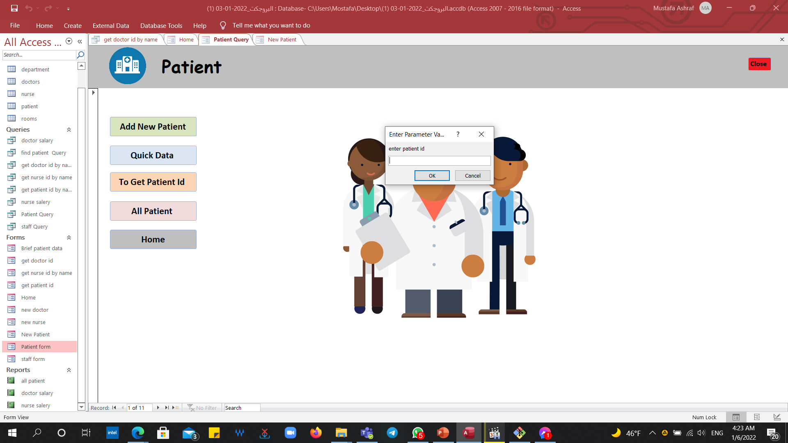

Slide 22
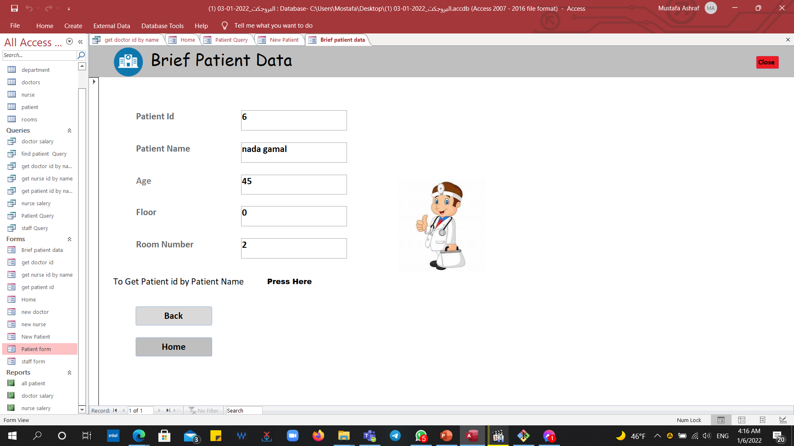

Slide 23
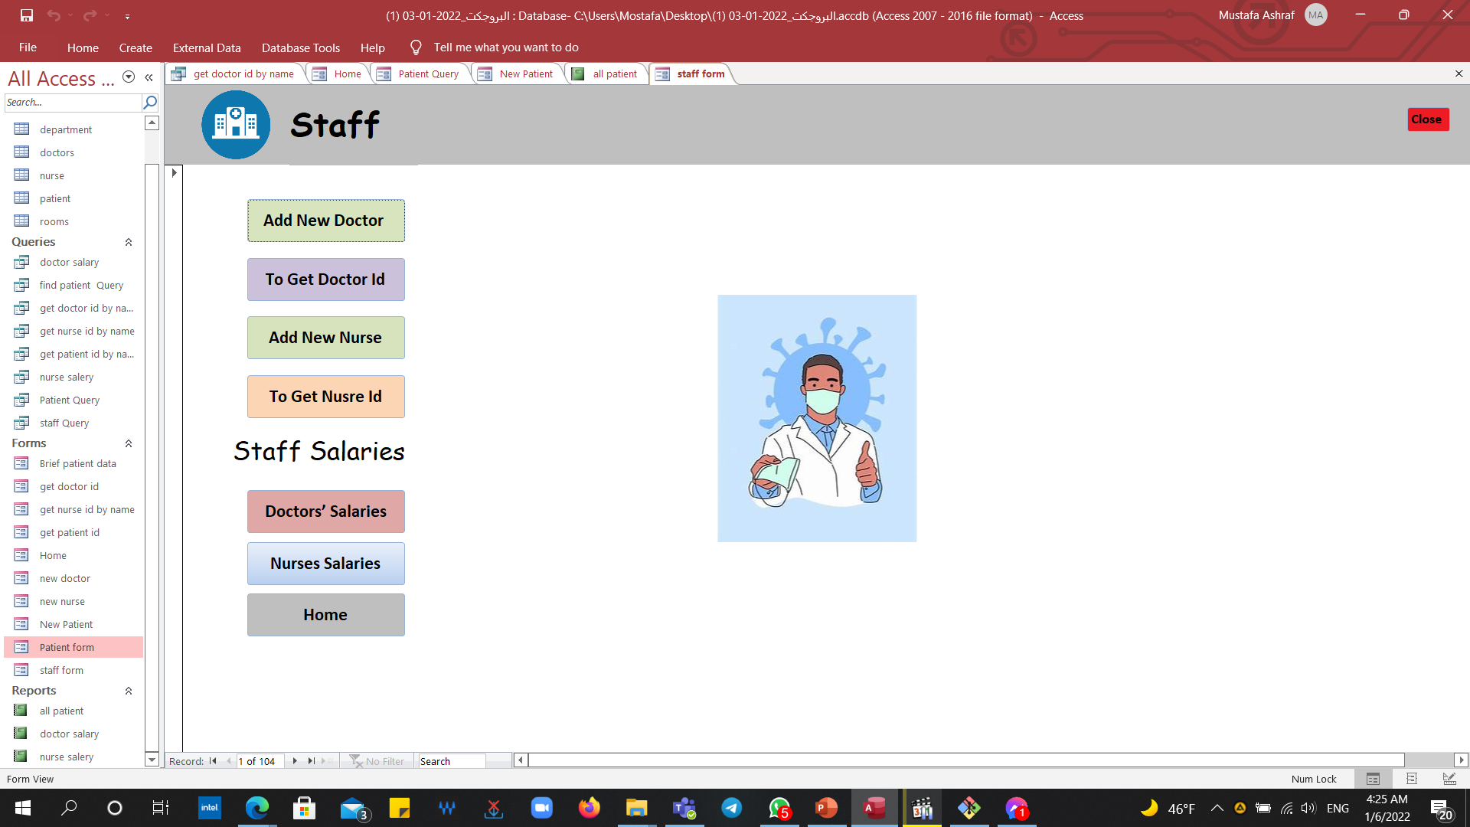

Slide 24
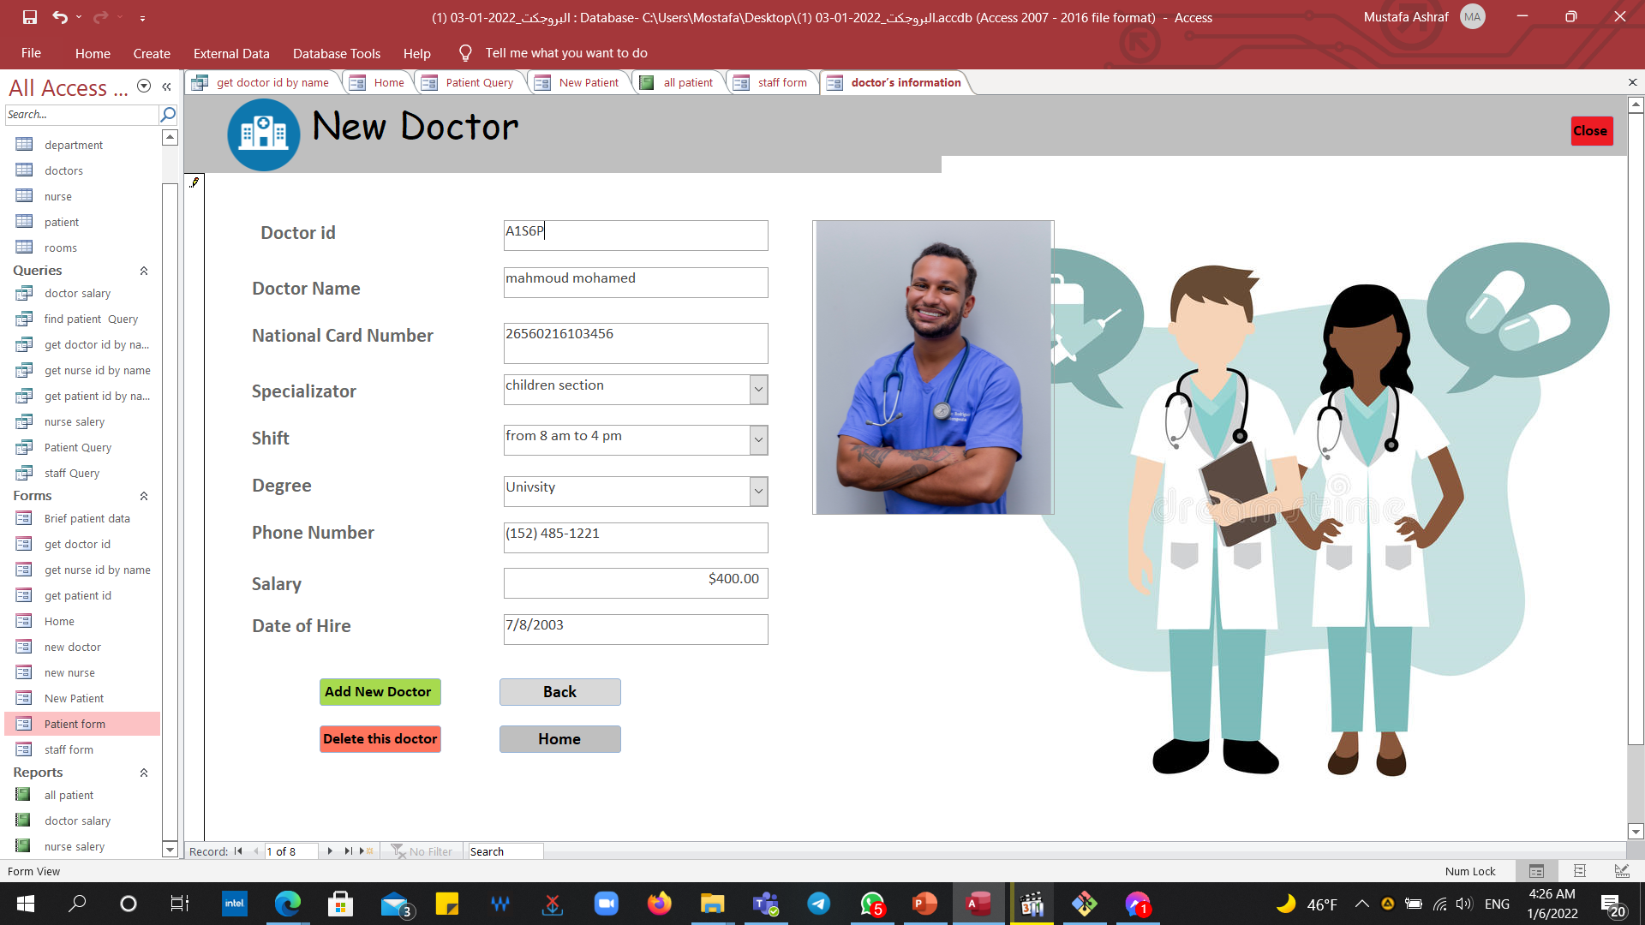

Slide 25
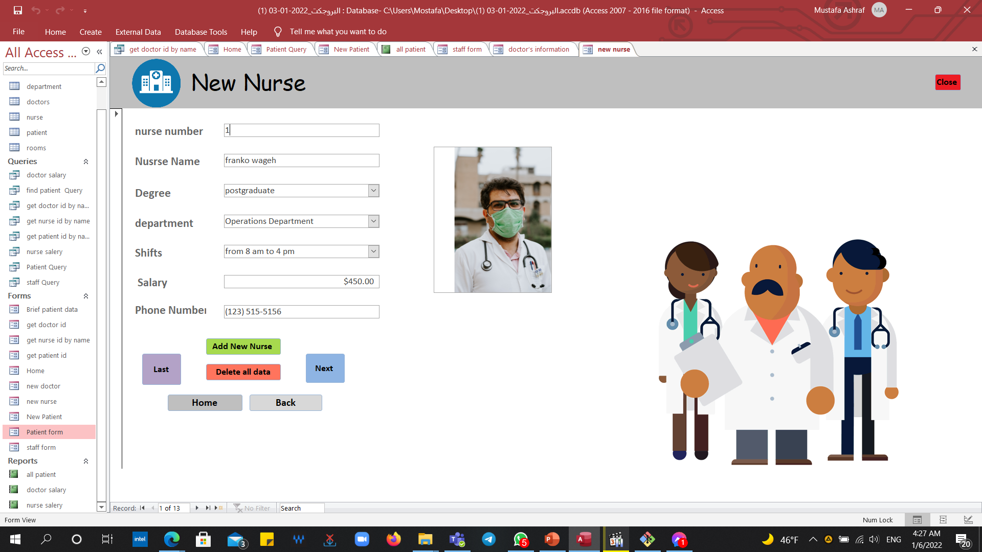

Slide 26
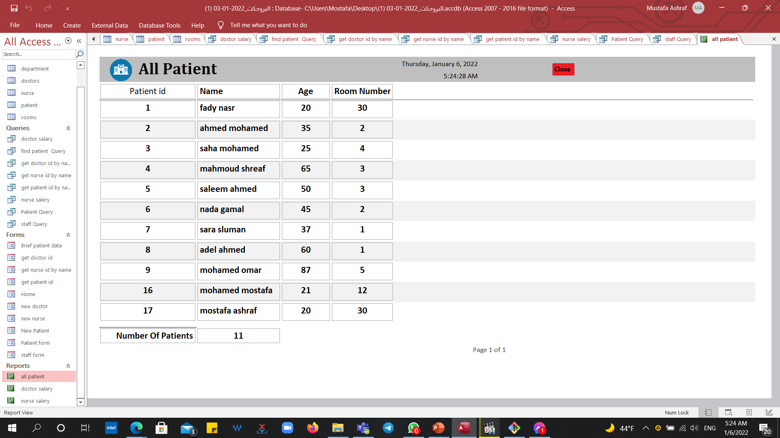
Reports :

Slide 27
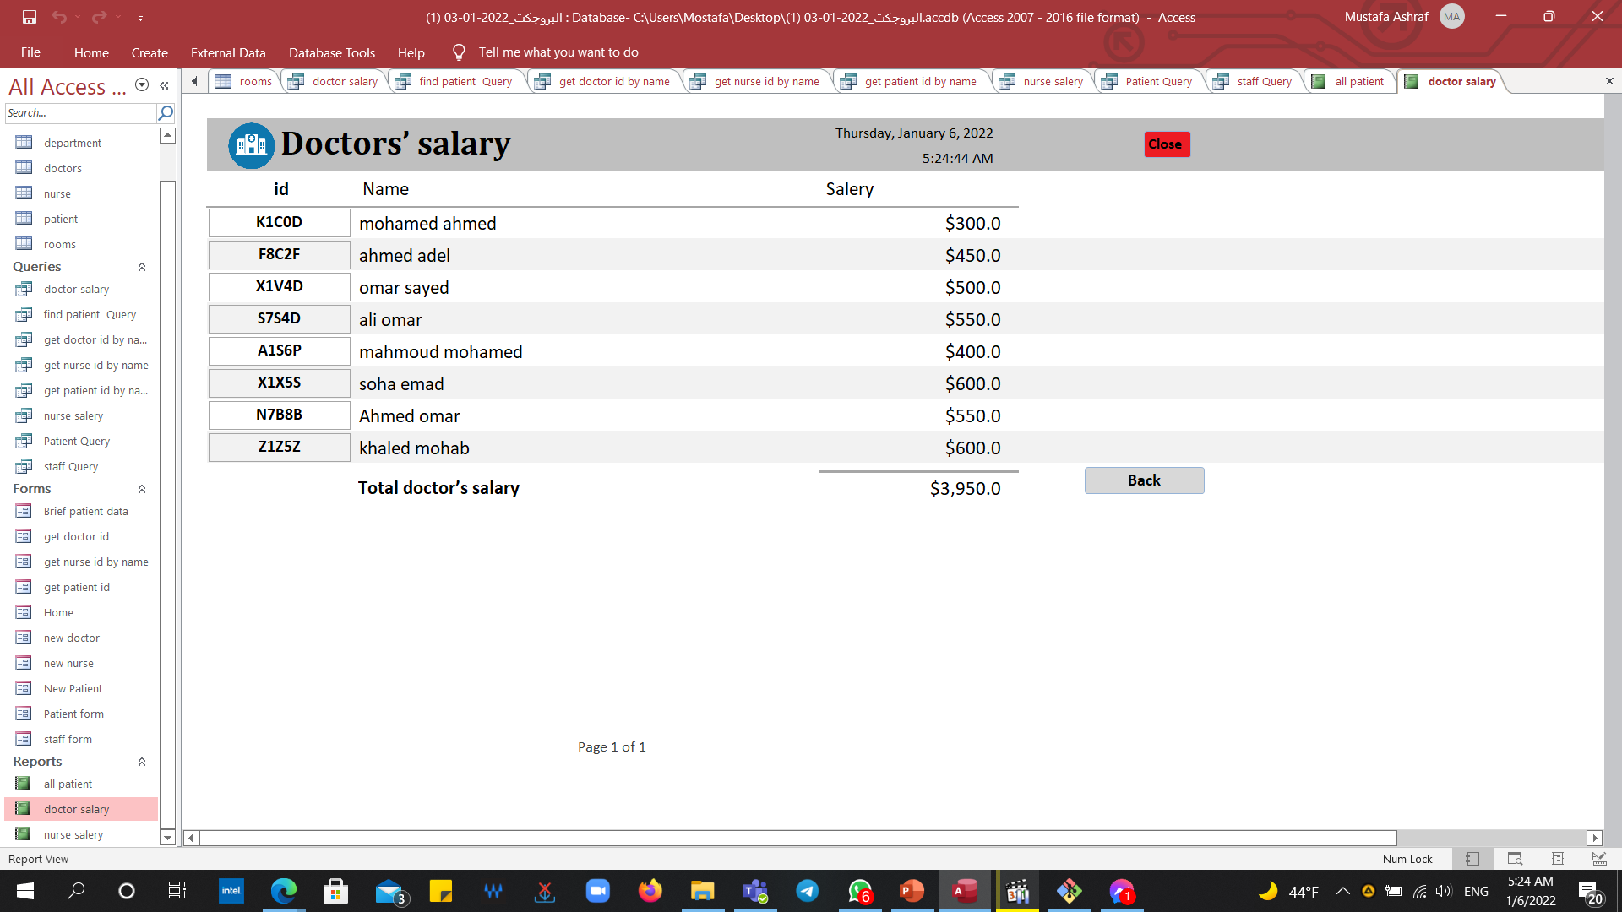

Slide 28
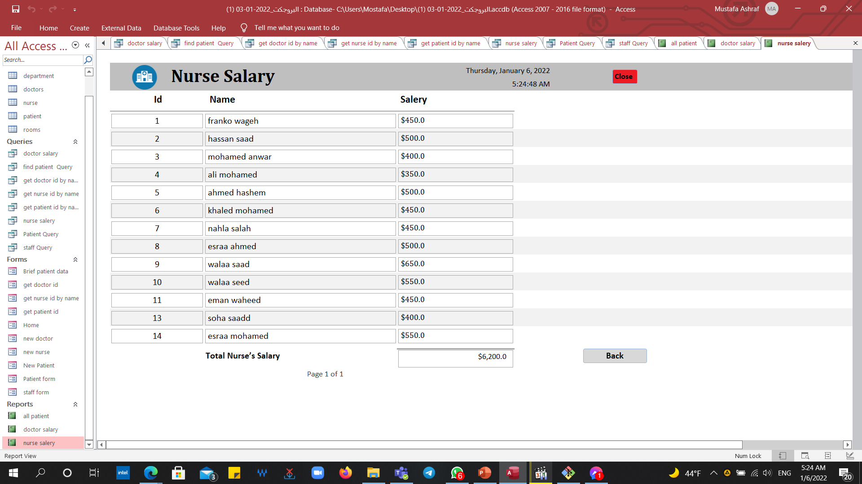

Slide 29
Group’s members
مصطفى اشرف على احمد.
محمود وائل سيد احمد.
مصطفى محمود محمد خليفه.

